Slide 1
Data Cleaning with Open Refine
Alison Blaine, ablaine@ncsu.edu
Jennifer Garrett, jigarret@ncsu.edu

Slide 2
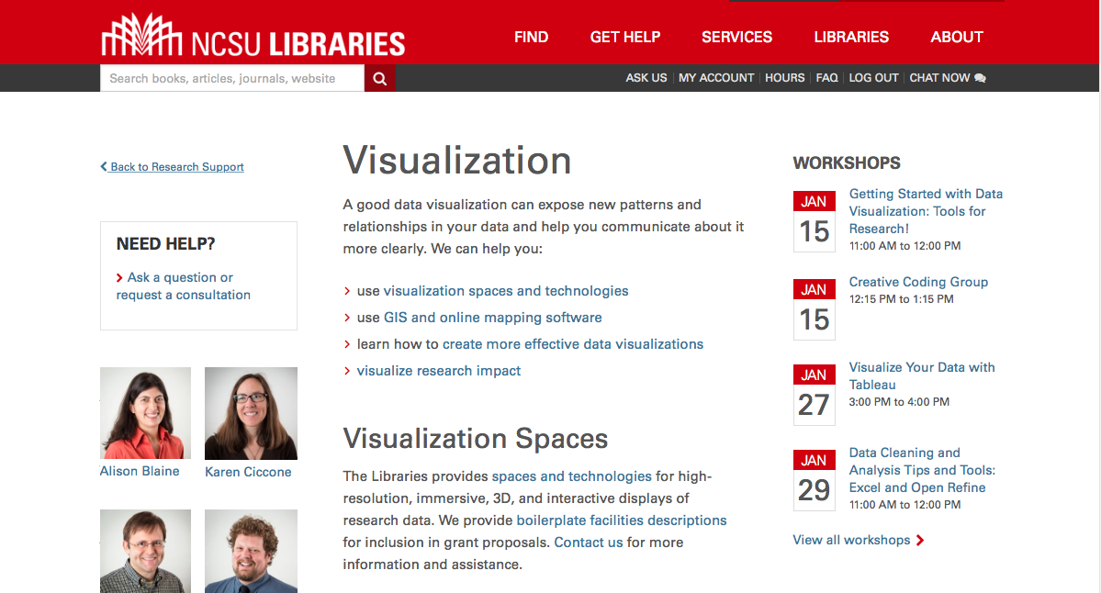
Data Visualization Services lib.ncsu.edu/do/visualization
Notes:
Alison
CHANGE THIS LINK to Visualization services

Slide 3
Data Visualization Process
getting data
getting to know the data
setting goals
determining if a visualization is needed
deciding what to visualize
cleaning
visualizing
potentially re-visualizing it with a different tool
exporting/embedding

Slide 4
Data cleaning
Cleaning data means removing problematic characters, whitespaces, symbols, errors, missing elements and inconsistencies.
Tools:
Open Refine
ASAP Utilities for Excel
Data cleaning using code in R or SAS

Slide 5
Open Refine
Formerly owned by Google, now maintained by independent developers.
Free, open source tool that makes it easy to clean and transform large data sets.
You can find problems in your data set without knowing about them in advance.
Requires downloading the software in order to use (http://openrefine.org/download.html)
GREL documentation: https://github.com/OpenRefine/OpenRefine/wiki/GREL-Functions

Slide 6
Today’s workshop materials
go.ncsu.edu/refine

